Slide 1
TEAM-ML_STARTERS
Problem Statement – 1:
Analyze Placement Data

Slide 2
TEAM MEMBERS : 1)TIRTHAJIT BORAL(LEADER) 2)SAMIRAN MAJUMDER 3)ATIF AKHTAR 4)MD TARIQUE HUSSAIN
Dataset : https://www.kaggle.com/datasets/revelation2k23/brain-dead-placement-data
Contest : Brain-Dead by Revelation ’23(via Unstop)

Slide 3
KEY POINTS : 1)DATA CLEANING AND PROCESSING 2)DATA VISUALISATION AND ANALYSIS 3)DETAILED ANALYSIS OF PERCENTAGE ON BAR PLOTS 4)ANSWER PROBABLE QUESTIONS ON DATASET 5)RESULTS AND DISCUSSIONS

Slide 4
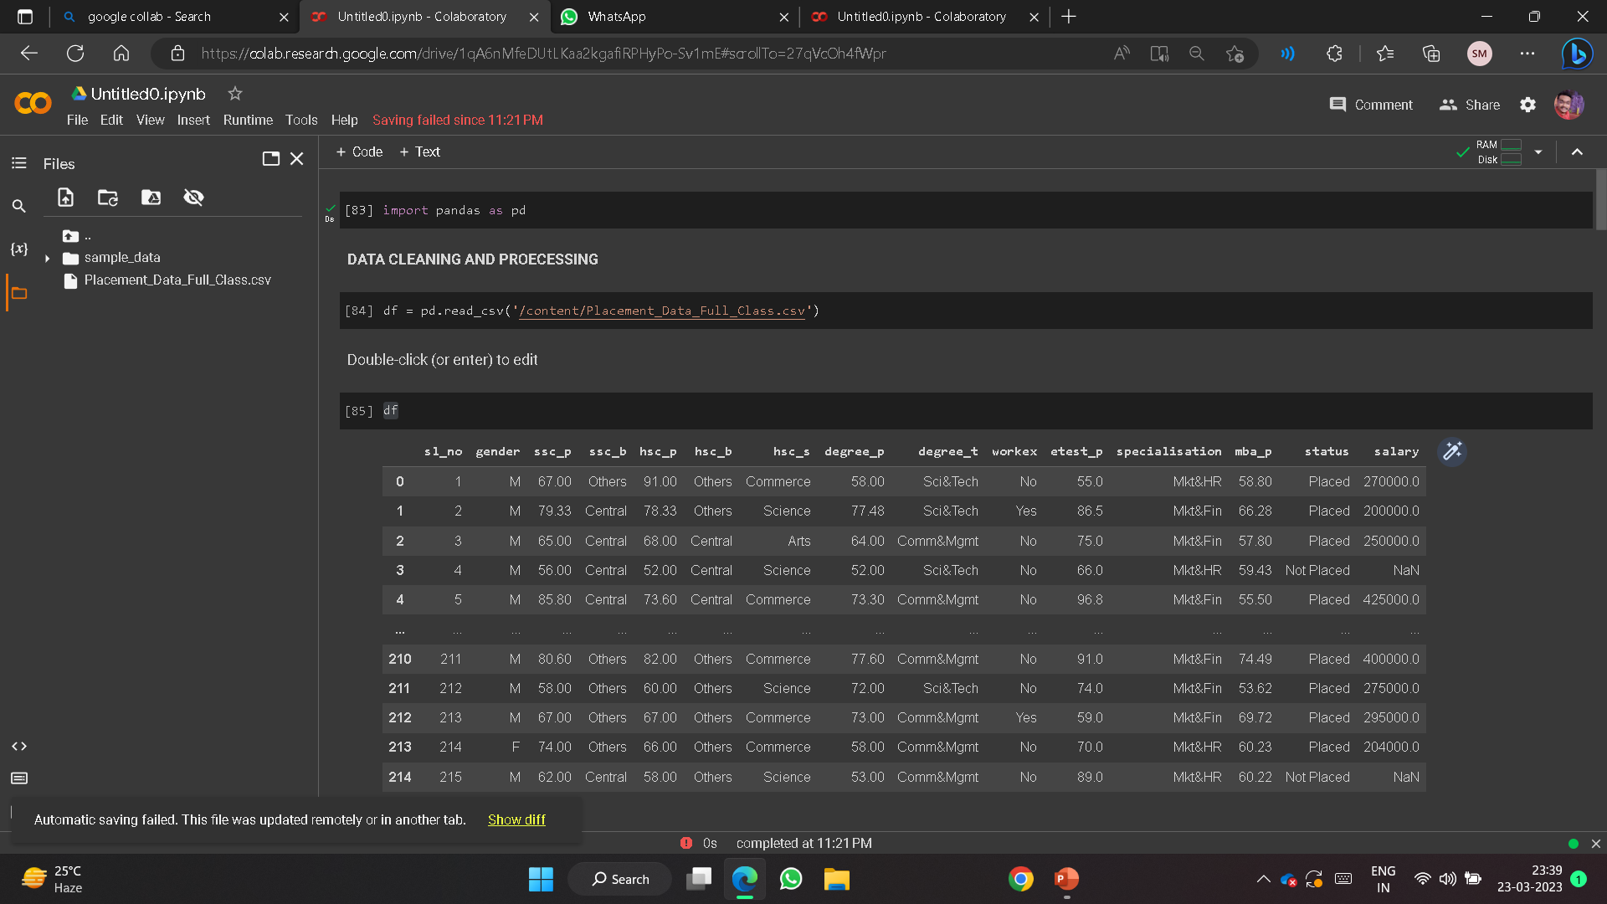
STEP 1 : DATA CLEANING and processing

Slide 5
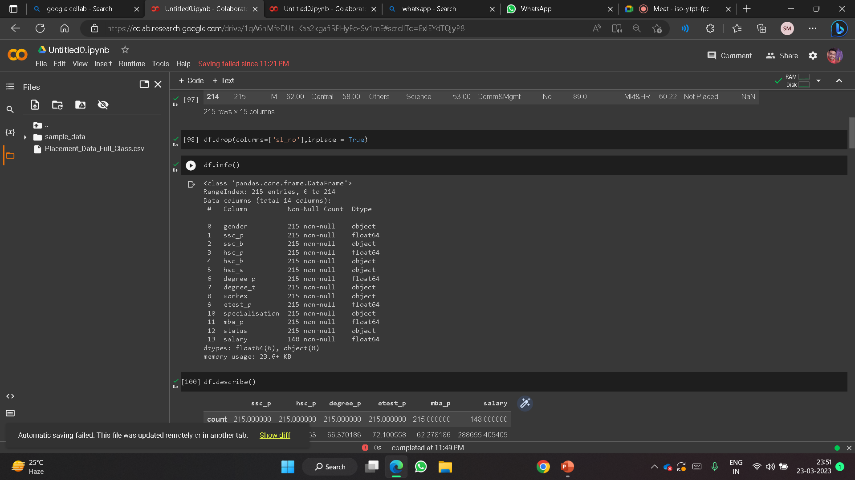

Slide 6
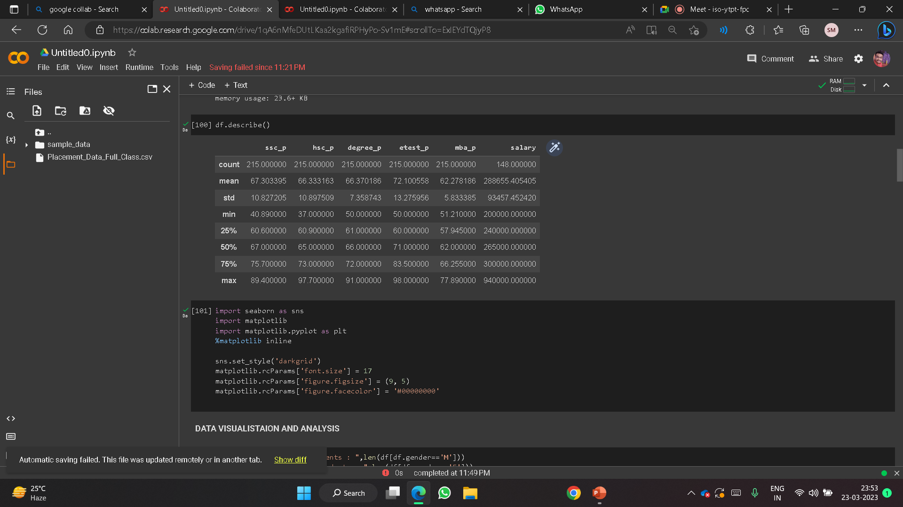

Slide 7
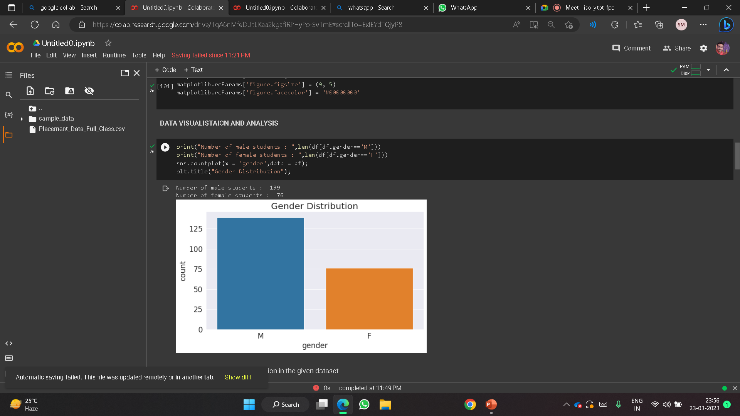
STEP 2 : DATA VISUALISATION AND ANALYSIS

Slide 8
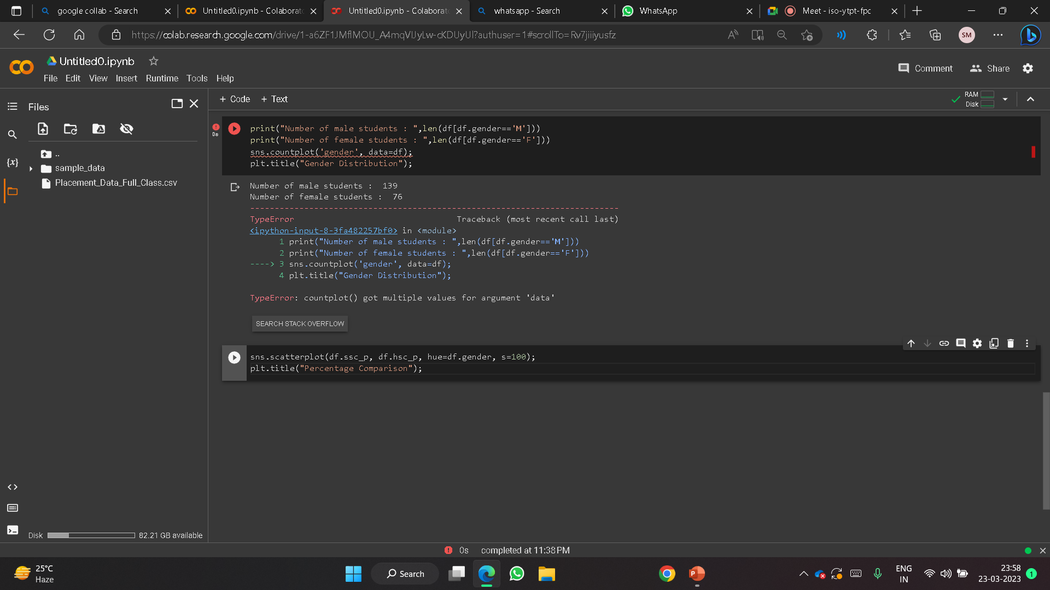
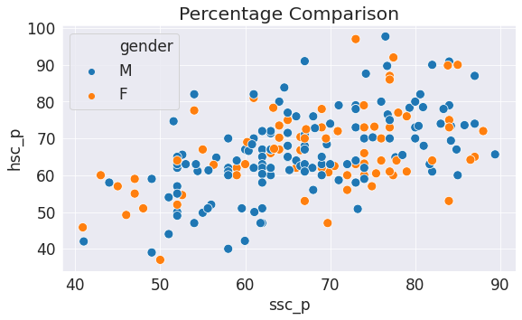
INFERENCE : MAXIMUM OF BOYS AND GIRLS STUDENT HAS SCORED A PERCENTAGE B/W 60 TO 70 AT SEC. AND HIGHER SEC. EDUCATION.

Slide 9
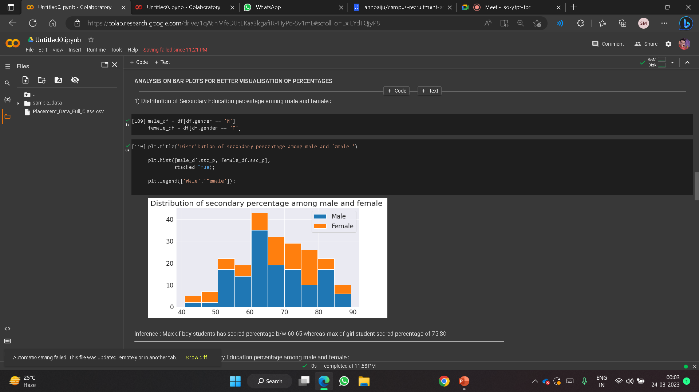
STEP 3: DETAILED ANALYSIS OF PERCENTAGE ON BAR PLOTS DISTRIBUTION OF SECONDARY EDUCATION PERCENTAGE AMONG MALE AND FEMALE :
INFERENCE : MAX OF BOY STUDENTS HAS SCORED PERCENTAGE B/W 60-65 WHEREAS MAX OF GIRL STUDENT SCORED PERCENTAGE OF 75-80

Slide 10
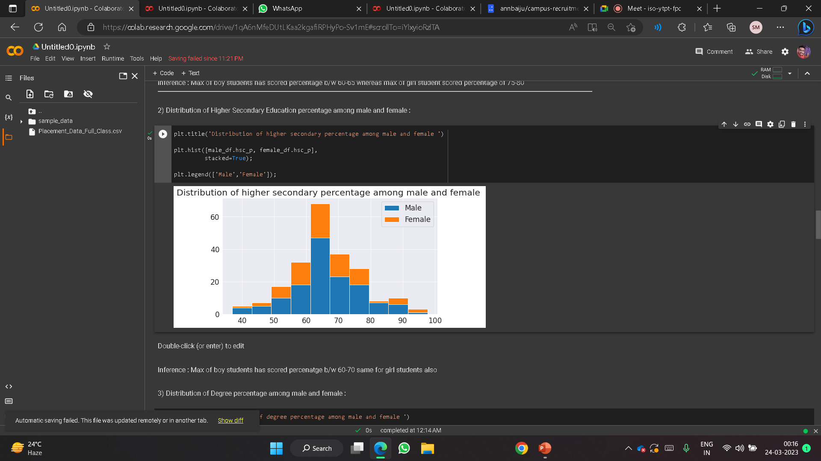
edit
DISTRIBUTION OF HIGHER SECONDARY EDUCATION PERCENTAGE AMONG MALE AND FEMALE:
INFERENCE : MAX OF BOY STUDENTS HAS SCORED PERCENTAGE B/W 60-70 SAME FOR GIRL STUDENTS ALSO

Slide 11
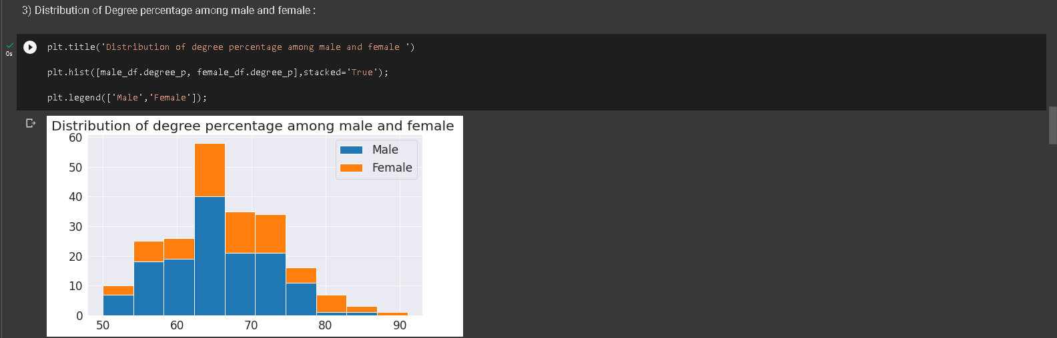
DISTRIBUTION OF DEGREE PERCENTAGE AMONG MALE AND FEMALE :
INFERENCE : MAX OF BOY STUDENTS HAS SCORED PERCENTAGE B/W 60-70 SAME FOR GIRL STUDENTS ALSO.

Slide 12
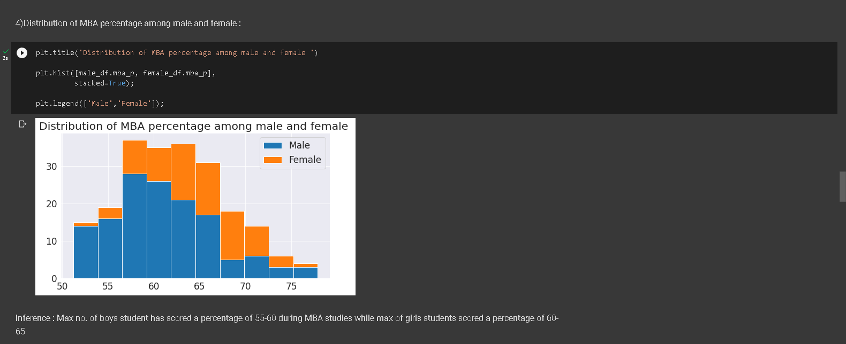
DISTRIBUTION OF MBA PERCENTAGE AMONG MALE AND FEMALE:
INFERENCE : MAX NO. OF BOYS STUDENT HAS SCORED A PERCENTAGE OF 55-60 DURING MBA STUDIES WHILE MAX OF GIRLS STUDENTS SCORED A PERCENTAGE OF 60-65

Slide 13
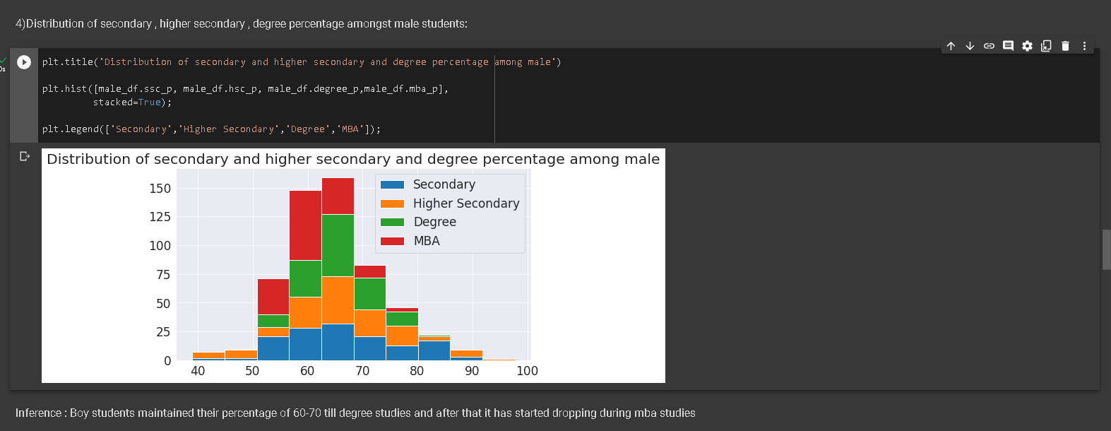
DISTRIBUTION OF SECONDARY , HIGHER SECONDARY , DEGREE PERCENTAGE AMONGST MALE STUDENTS:
INFERENCE : BOY STUDENTS MAINTAINED THEIR PERCENTAGE OF 60-70 TILL DEGREE STUDIES AND AFTER THAT IT HAS STARTED DROPPING DURING MBA STUDIES

Slide 14
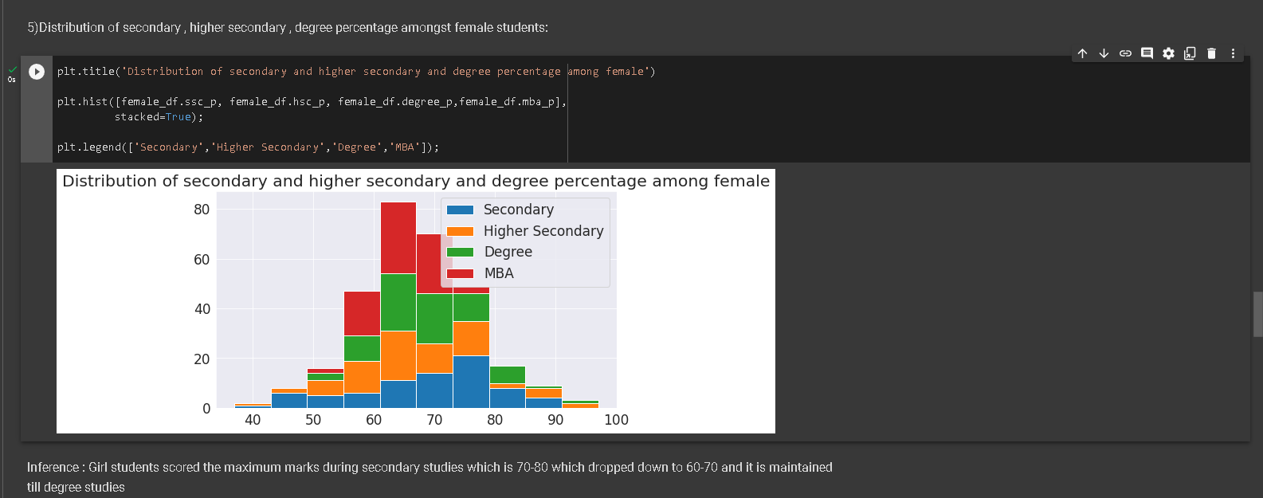
DISTRIBUTION OF SECONDARY , HIGHER SECONDARY , DEGREE PERCENTAGE AMONGST FEMALE STUDENTS:
INFERENCE : GIRL STUDENTS SCORED THE MAXIMUM MARKS DURING SECONDARY STUDIES WHICH IS 70-80 WHICH DROPPED DOWN TO 60-70 AND IT IS MAINTAINED TILL DEGREE STUDIES

Slide 15
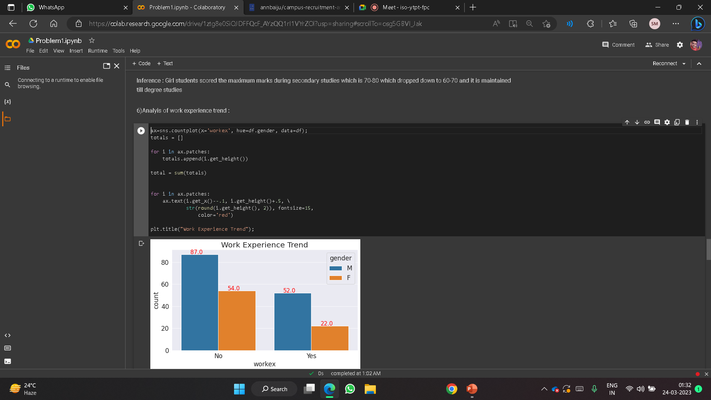
6)ANALYIS OF WORK EXPERIENCE TREND :
INFERENCE : 52 OUT OF 139 BOYS HAVE WORK EXPIRIENCE AND ONLY
22 OUT OF 76 GIRLS HAVE WORK EXPERIENCE

Slide 16
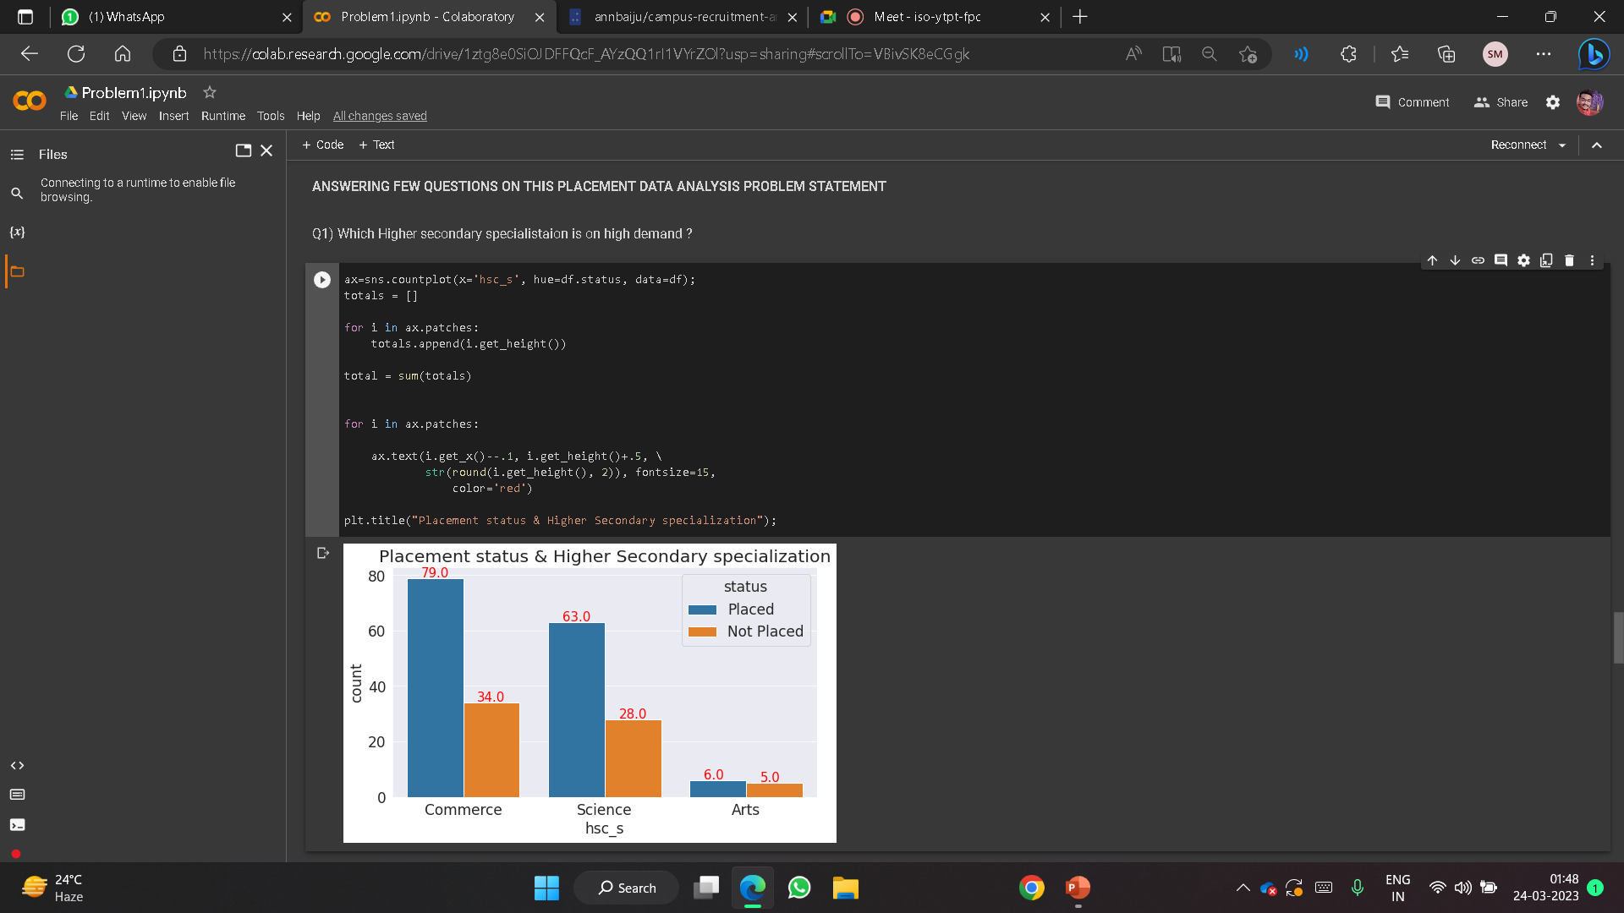
STEP 4 : PROBABLE QUESTIONS ON DATASET
Q1) WHICH HIGHER SECONDARY SPECIALISATION IS ON HIGH DEMAND?
INFERENCE : FROM BAR CHART PLOT IT IS CLEAR THAT SPECIALISATION IN “COMMERCE” IS ON HIGH DEMAND IN TERMS OF PLACEMENT

Slide 17
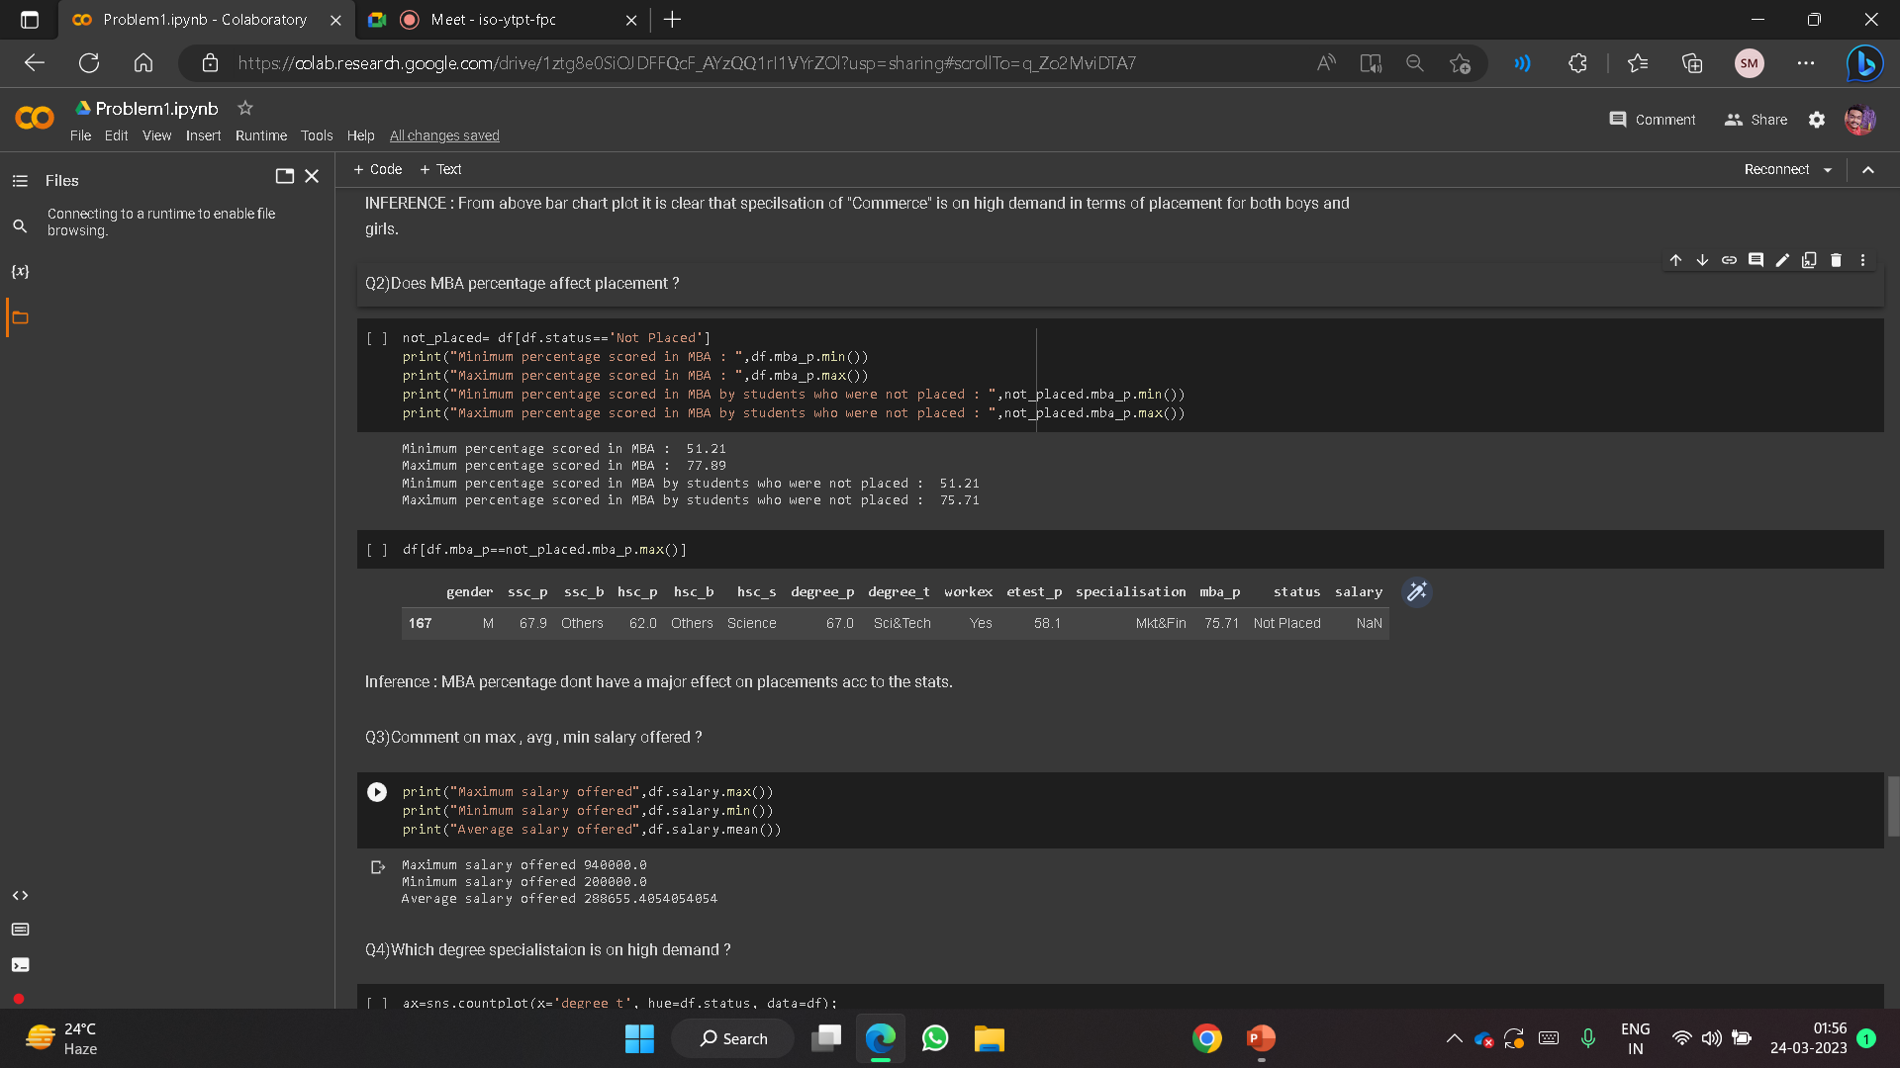
Q2)DOES MBA PERCENTAGE AFFECT PLACEMENT ?
INFERENCE : MBA PERCENTAGE DON’T HAVE A MAJOR EFFECT ON PLACEMENT

Slide 18
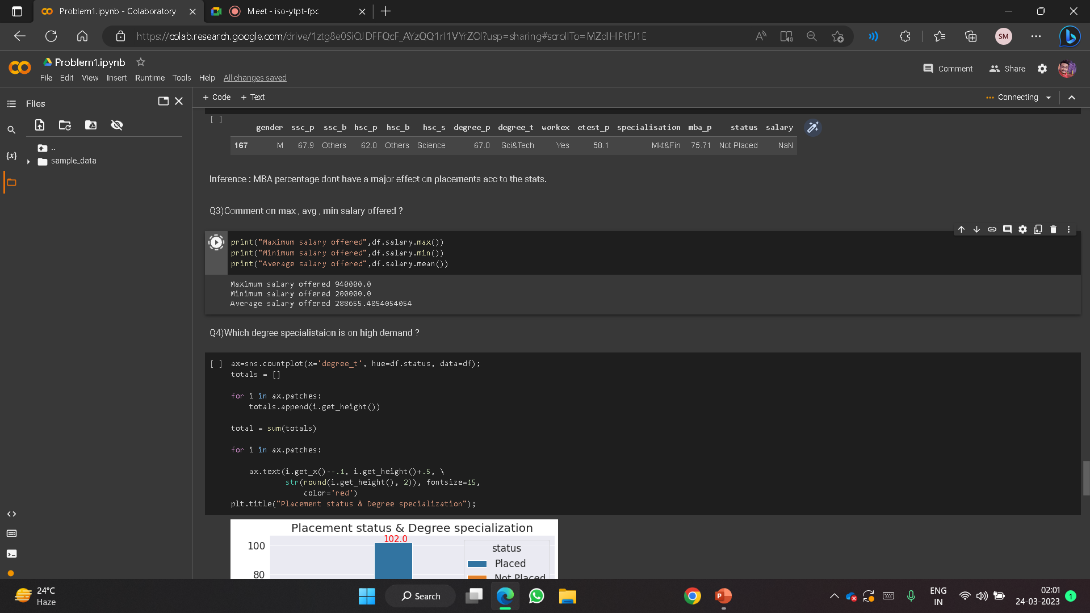
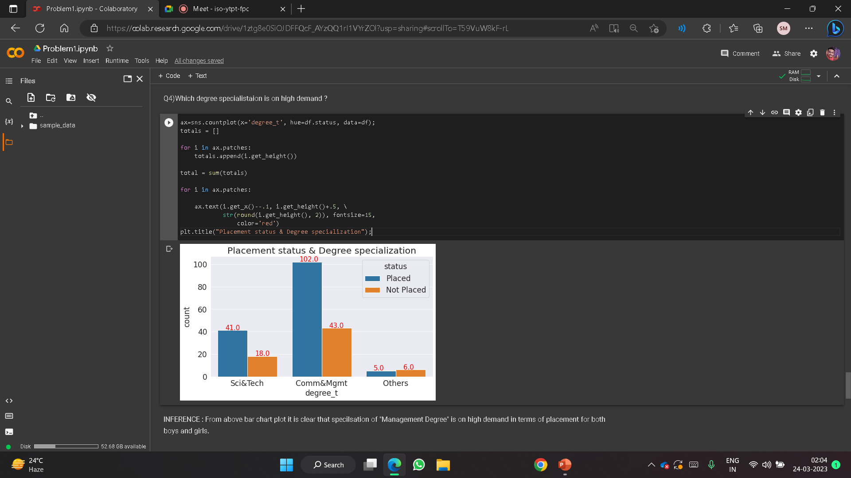
Q3)COMMENT ON MAXIMUM , AVERAGE , MINIMUM SALARY OFFERED ?
Q4)WHICH DEGREE SPECIALISTAION IS ON HIGH DEMAND ?

Slide 19
INFERENCE : FROM ABOVE BAR CHART PLOT IT IS CLEAR THAT SPECIALISATION ON "MANAGEMENT DEGREE" IS ON HIGH DEMAND IN TERMS OF PLACEMENT FOR BOTH BOYS AND GIRLS

Slide 20
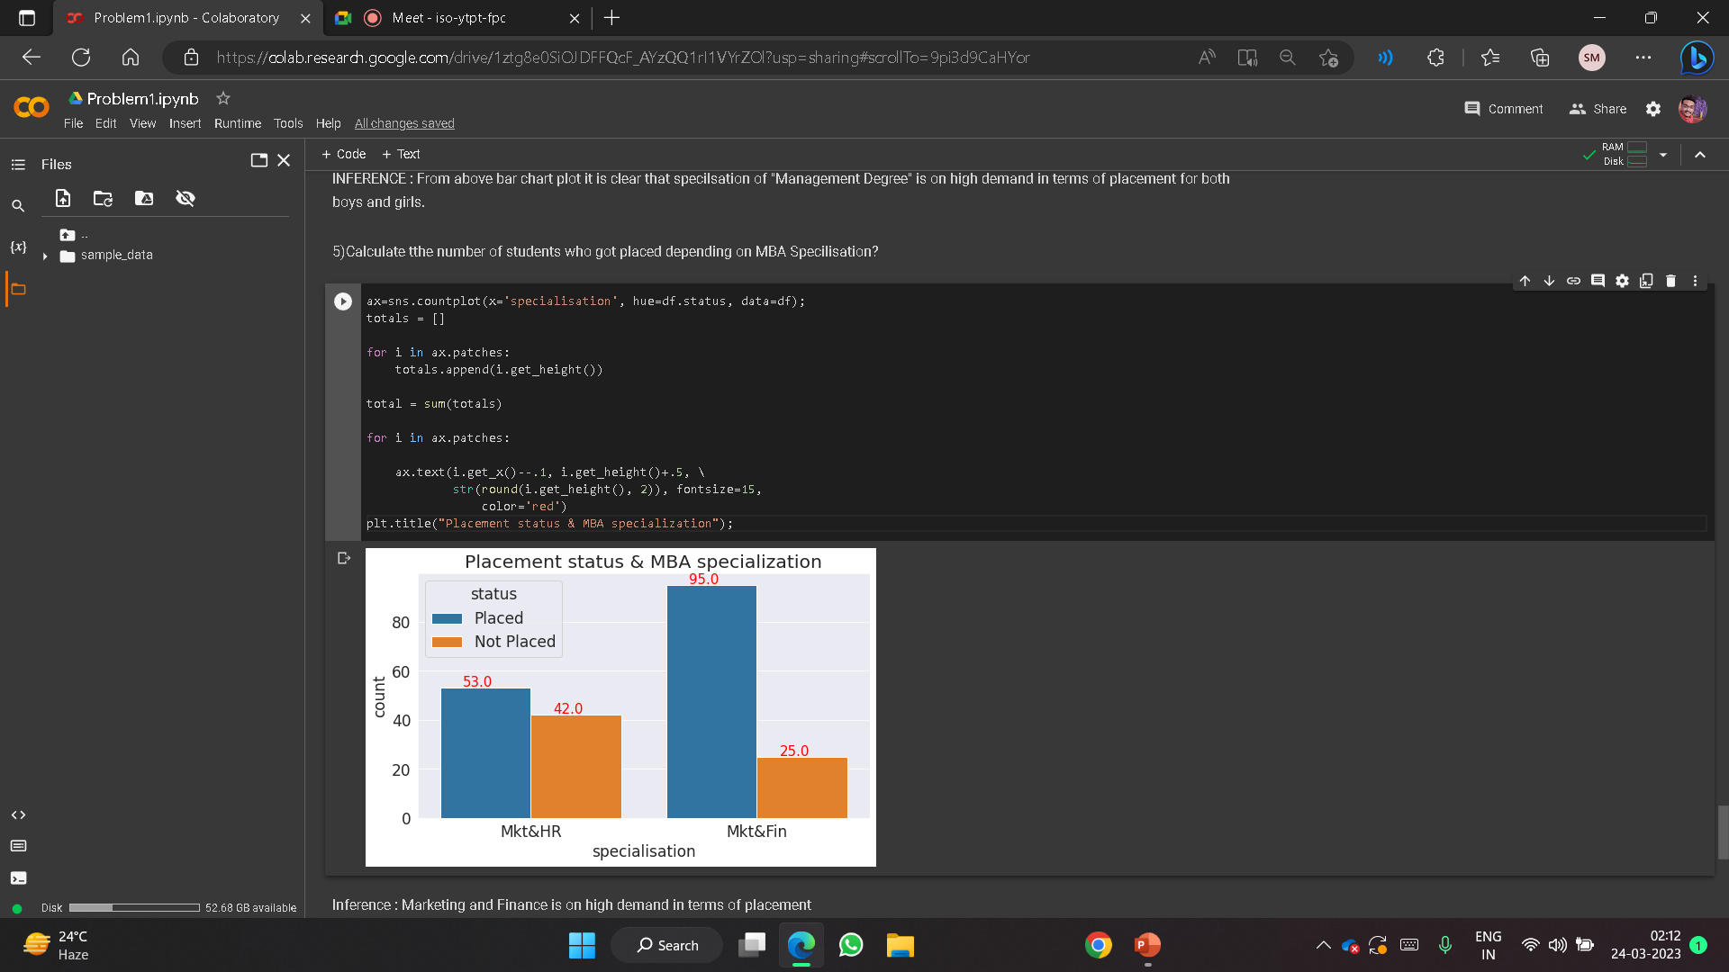
5)CALCULATE THE NUMBER OF STUDENTS WHO GOT PLACED DEPENDING ON MBA SPECILISATION
INFERENCE : MARKETING AND FINANCE IS ON HIGH DEMAND IN ACCOUNT OF PLACEMENT

Slide 21
STEP 5 : RESULTS AND DISCUSSIONS
So from the analysis that we have made we can conclude that:
1)The placement percentage of the campus is 68.8, which is not bad and the maximum salary offered is 9,40,000 and 24% of students were offered more than average salary of 2,88,655.
2)MBA percentage does not have much effect on getting placed. As we saw, even a student with high percentage as 75.71 and having work experience is not placed. Having a work experience will increase your chance of getting placed. We saw that, out of 74 students who had work experience 64 of them got placed in comparison to students who didn’t have a work experience.

Slide 22
3)We can also predict what type of specialization in MBA is preferred by employers, Marketing and Finance. Out of 120 students who specialized in Marketing and Finance, 95 of them were placed whereas in Marketing and HR, its almost a 50-50 chance of placement.
4)We can also see that the degree specialization also affects employment. Employers prefer those who have studied Commerce and Management degree.
Therefore we can conclude that, in order to achieve a management job with better salary offers, its better to choose Commerce and Management for degree specialization and Marketing and Finance for MBA specialization along with a work experience

Slide 23
TEAM-ML_Starters Problem Statement-2
Detecting Emotional Sentiment in Cartoons
Data-set: https://www.kaggle.com/datasets/revelation2k23/brain-dead-emotion-detection

Slide 24
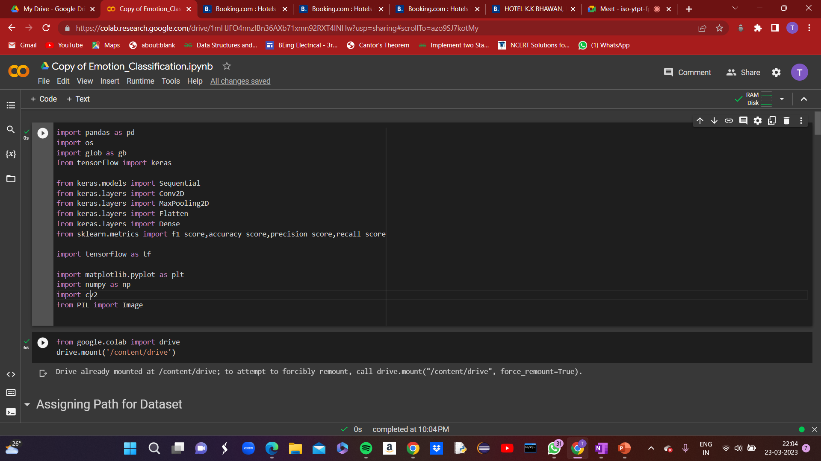
Step-1:Importing Libraries

Slide 25
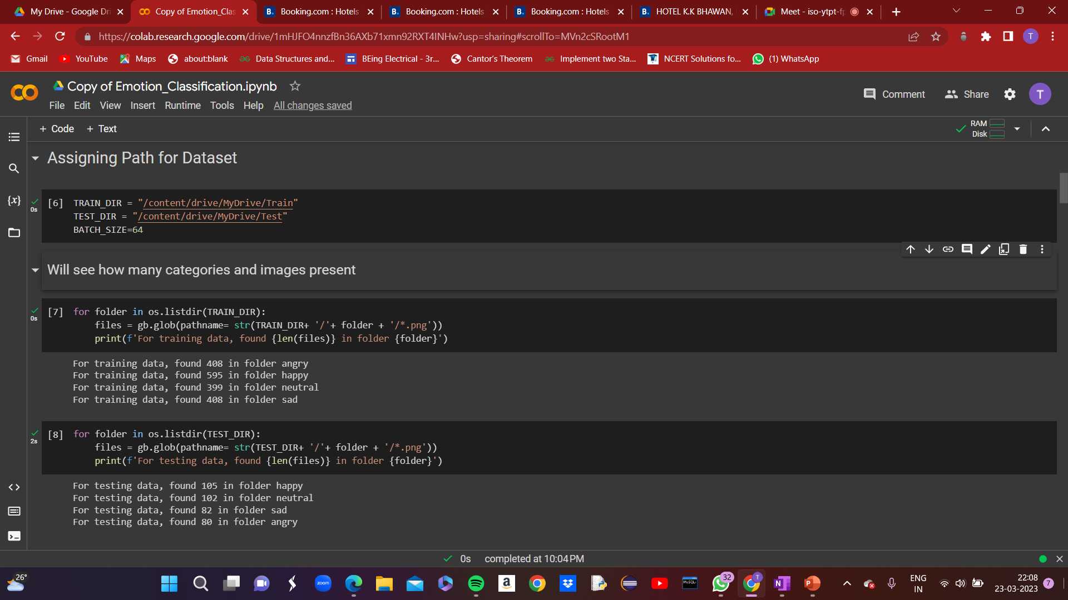
Step-2:Data Exploration

Slide 26
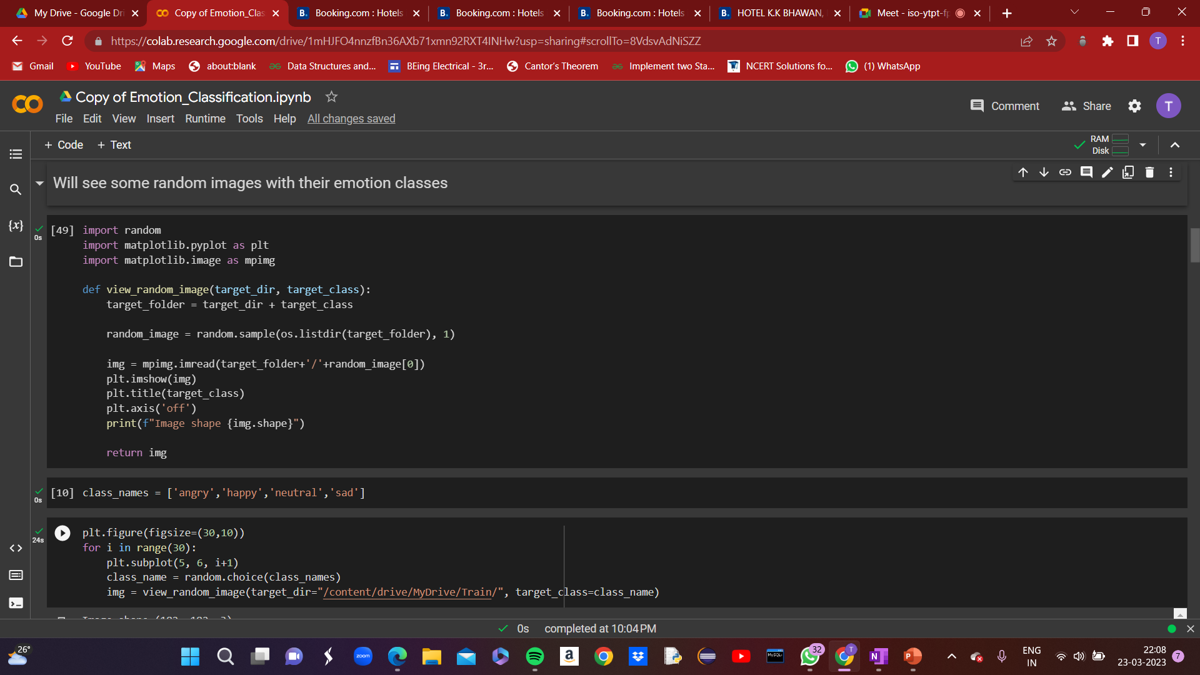
Step-2:Data Exploration

Slide 27
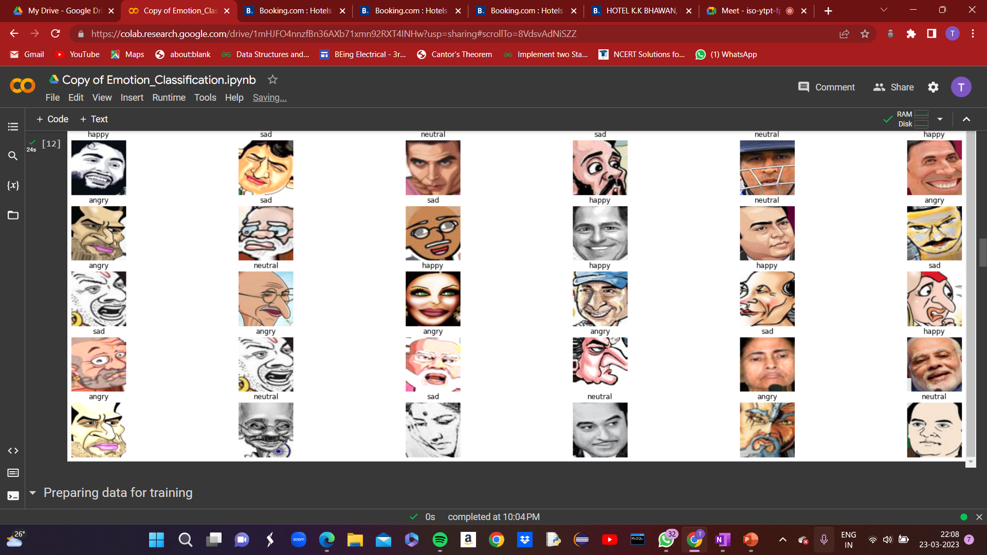
Step-2:Data Exploration (Random Images Classification)

Slide 28
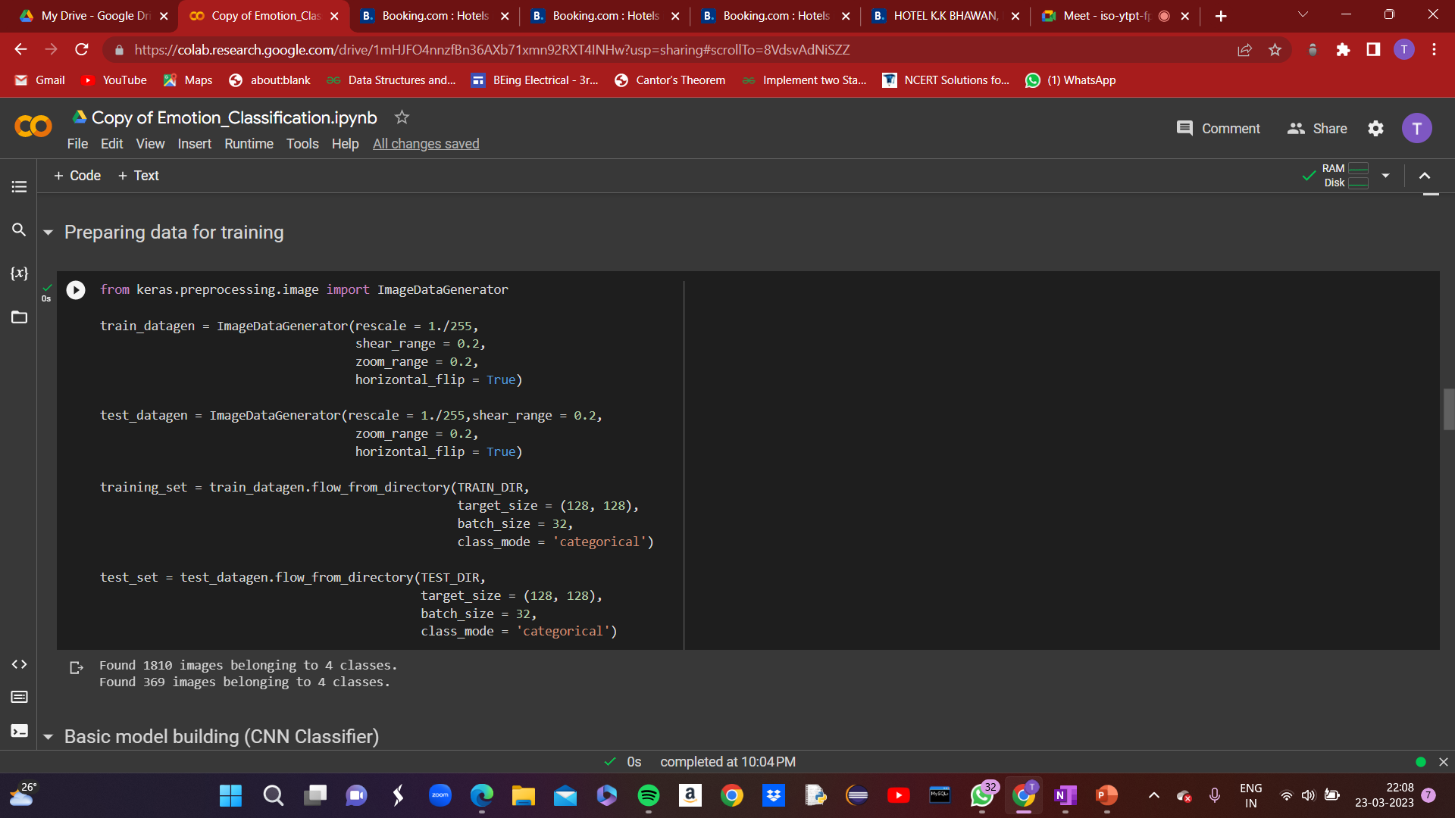
Step-3:Data Training of Model

Slide 29
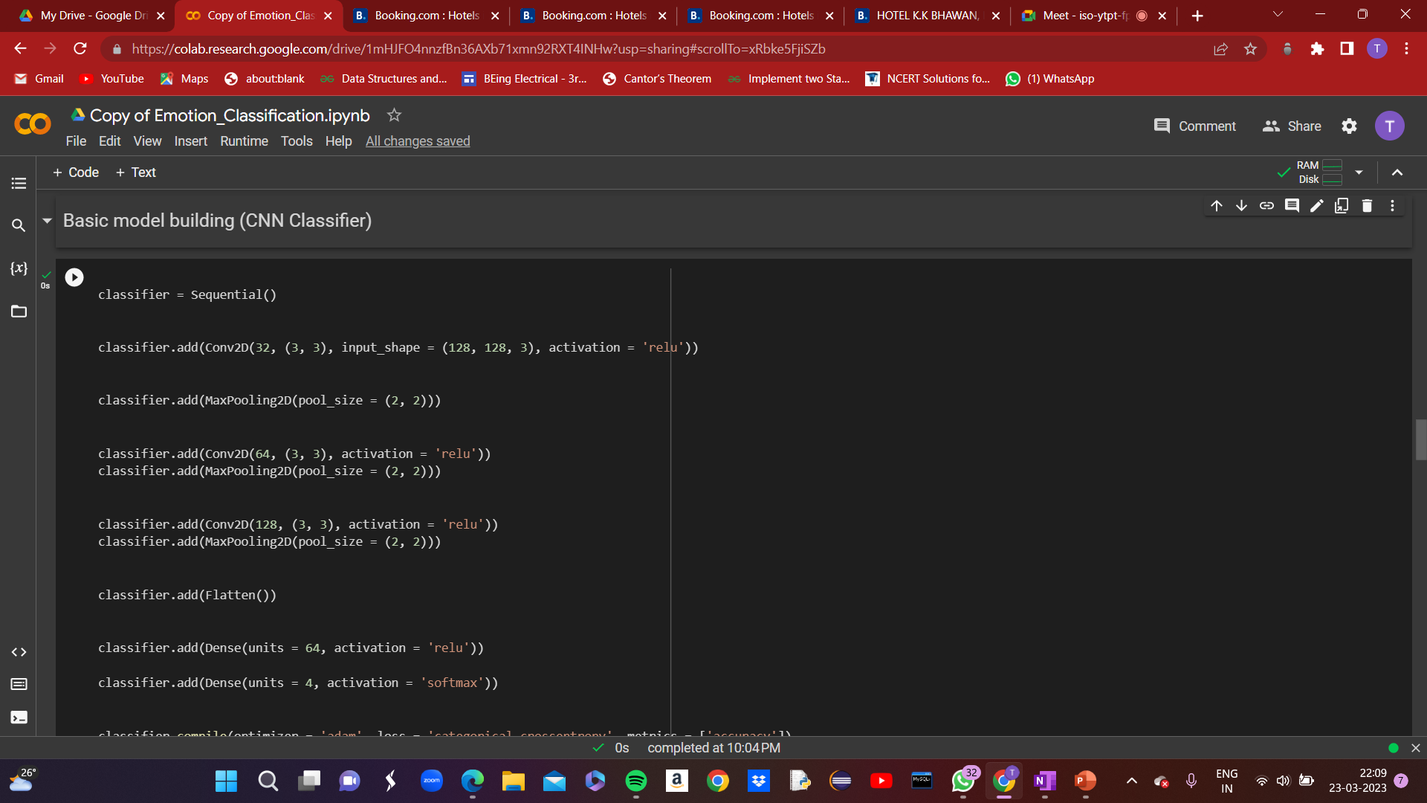
Step-4:Sequential CNN Model

Slide 30
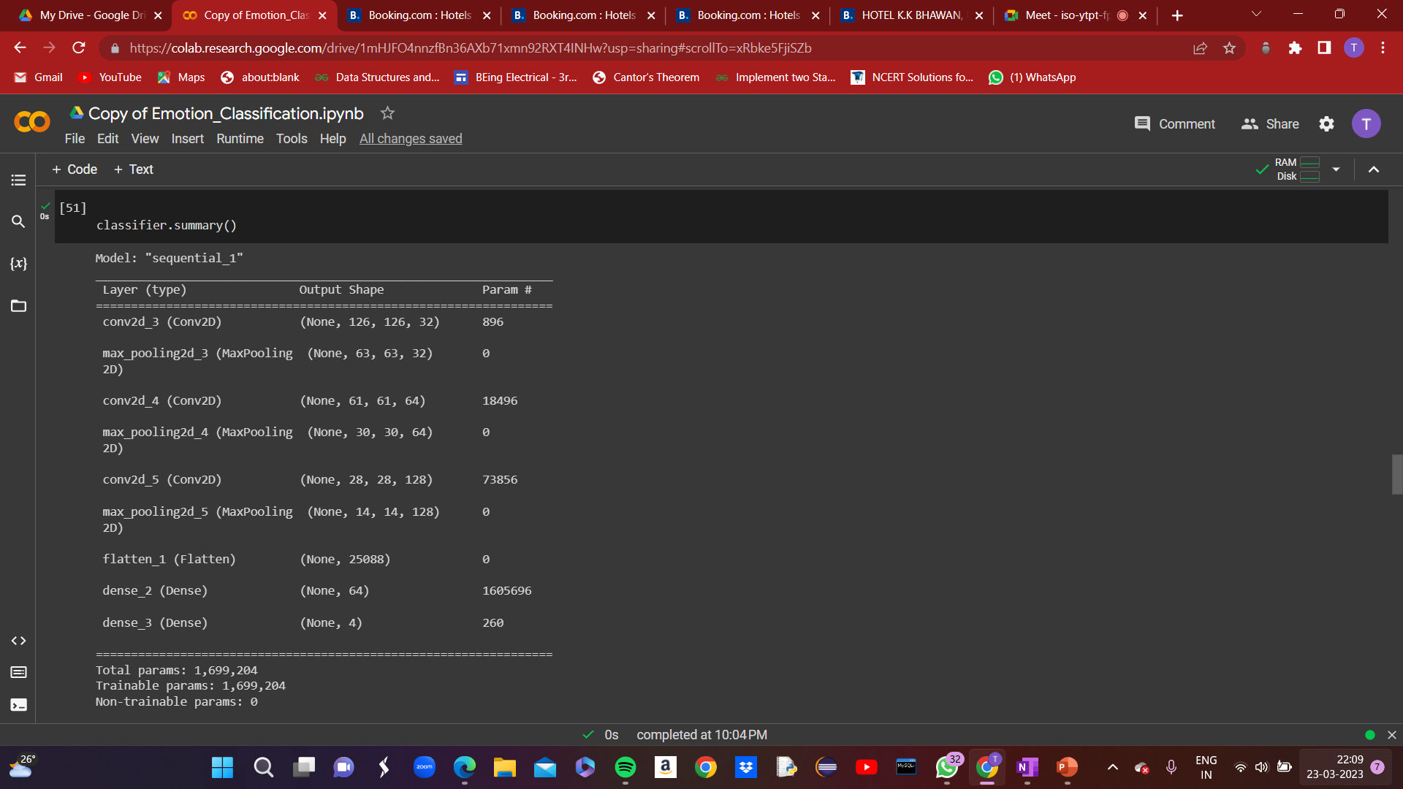
Step-4:Sequential CNN Model(Summary)

Slide 31
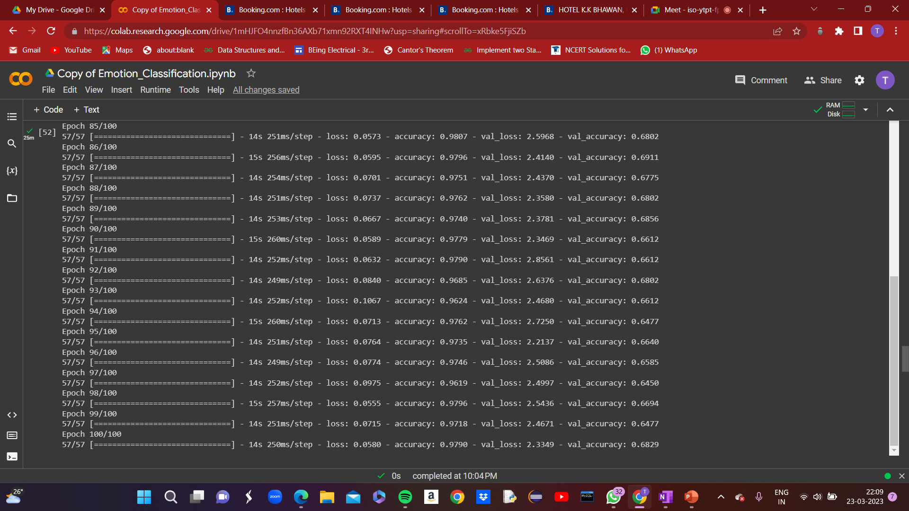
Training in progress…..

Slide 32
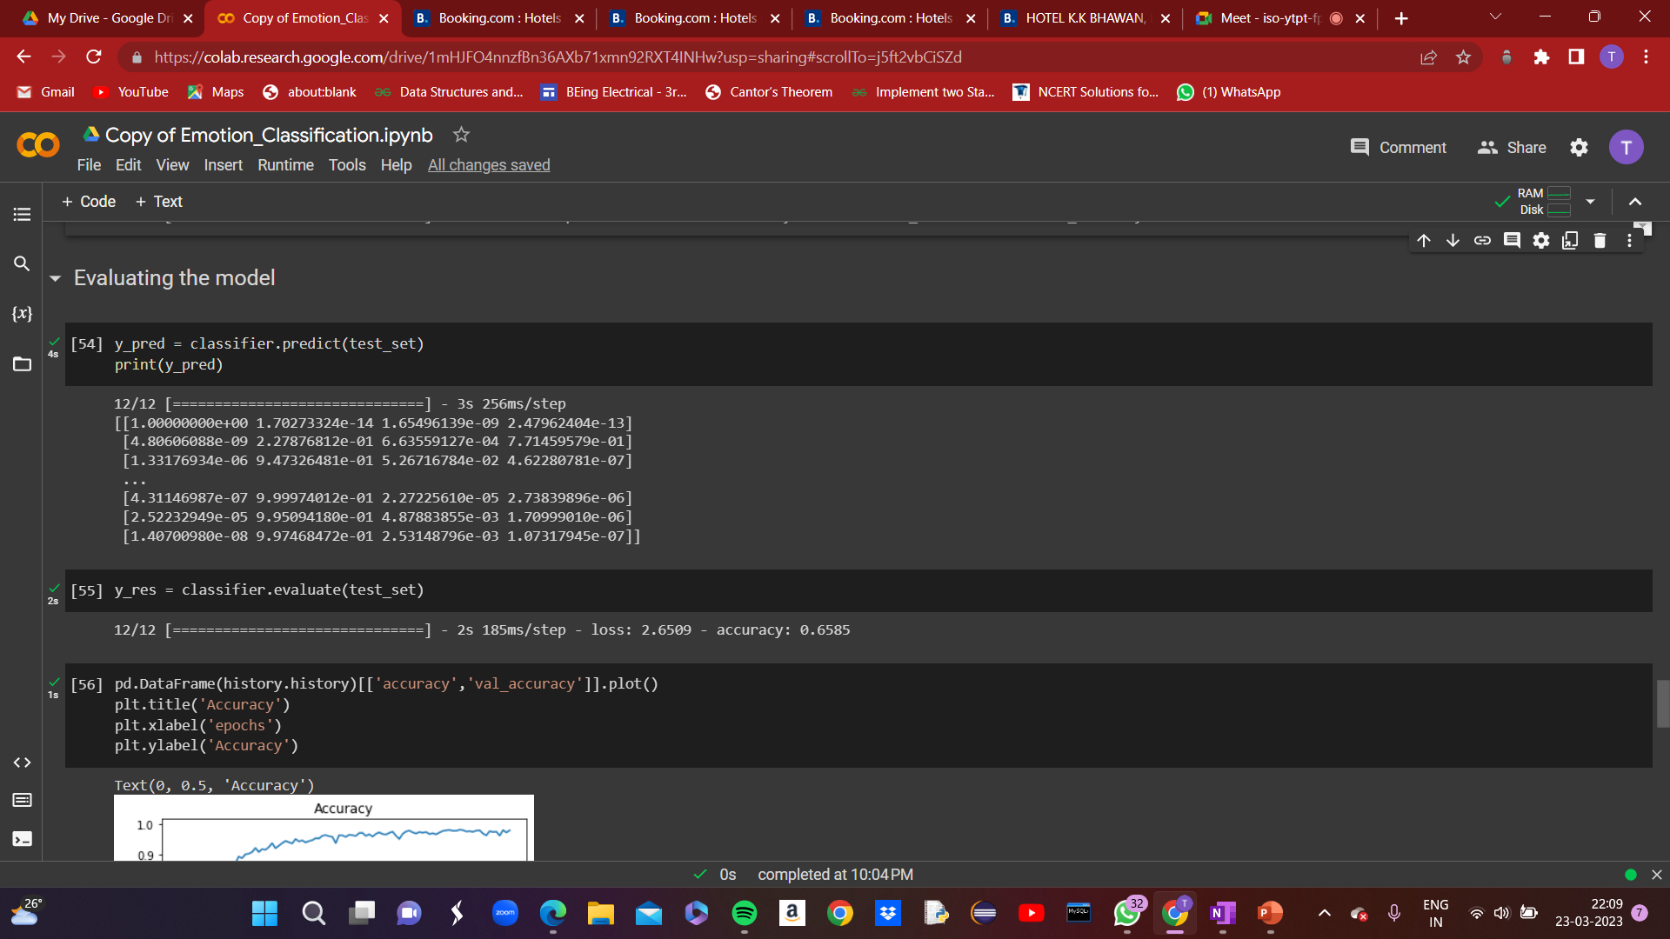
Step-5:Sequential Model Evaluation

Slide 33
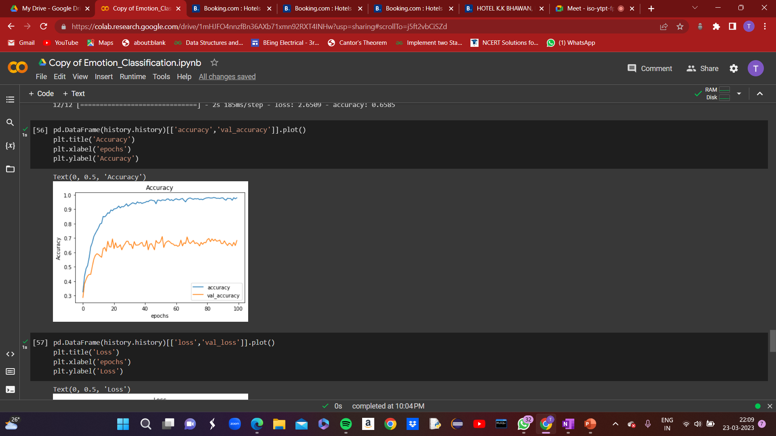
Step-5:Sequential Model Evaluation (Plot showing Accuracy v/s Epoch)

Slide 34
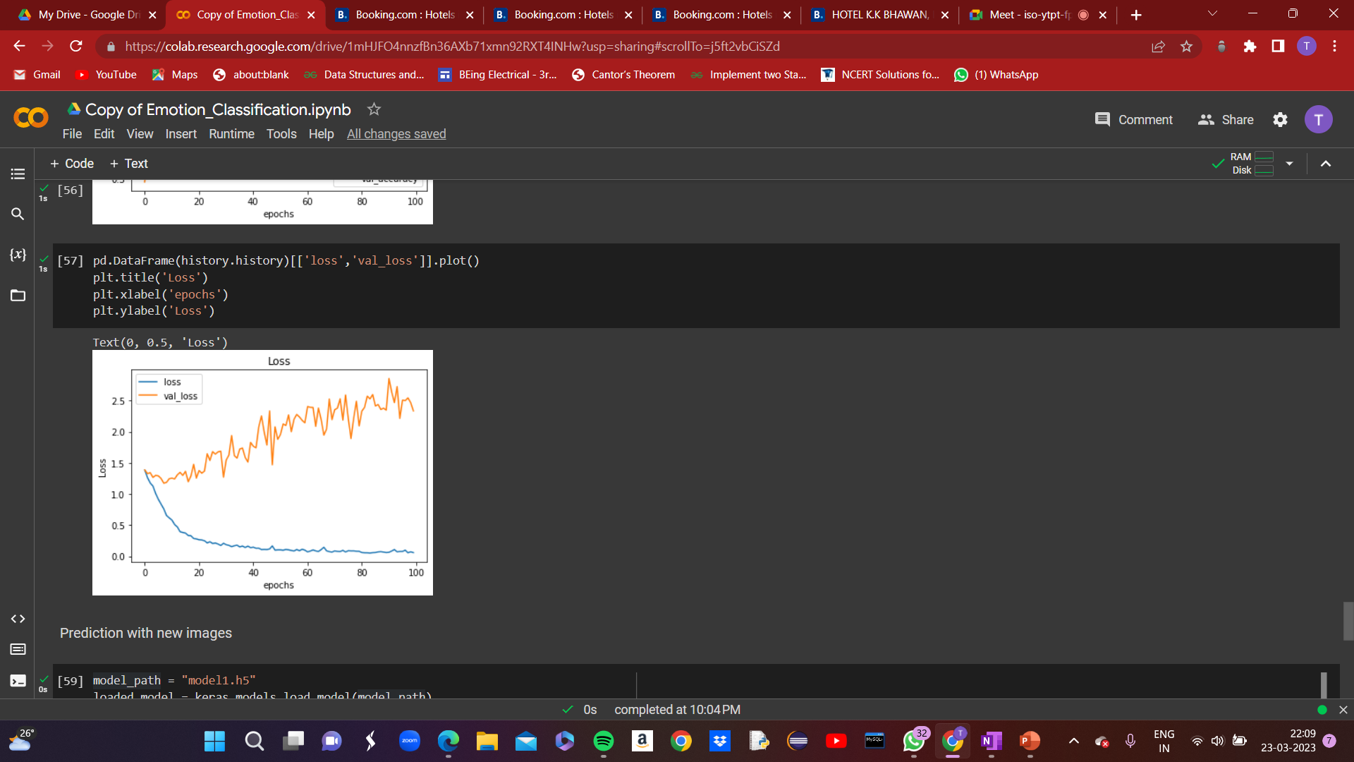
Step-5:Sequential Model Evaluation (Plot showing Loss v/s Epoch)

Slide 35

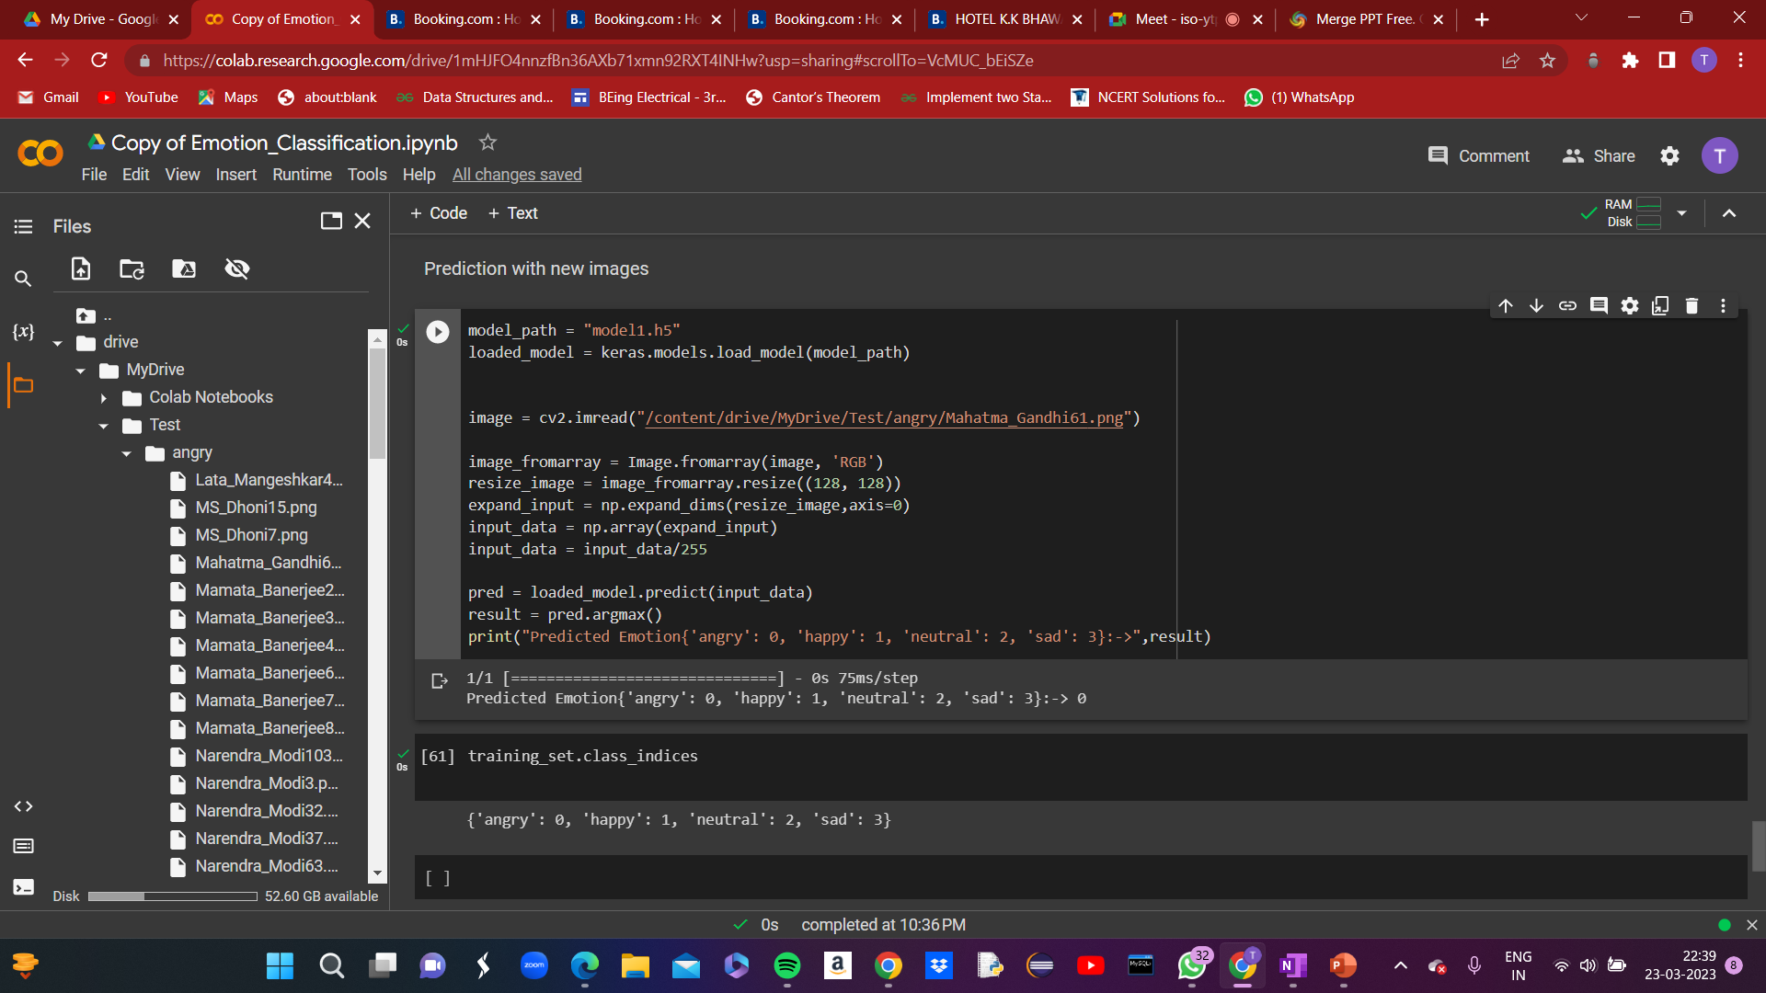
Step-6:Real World Prediction(Angry)

Slide 36

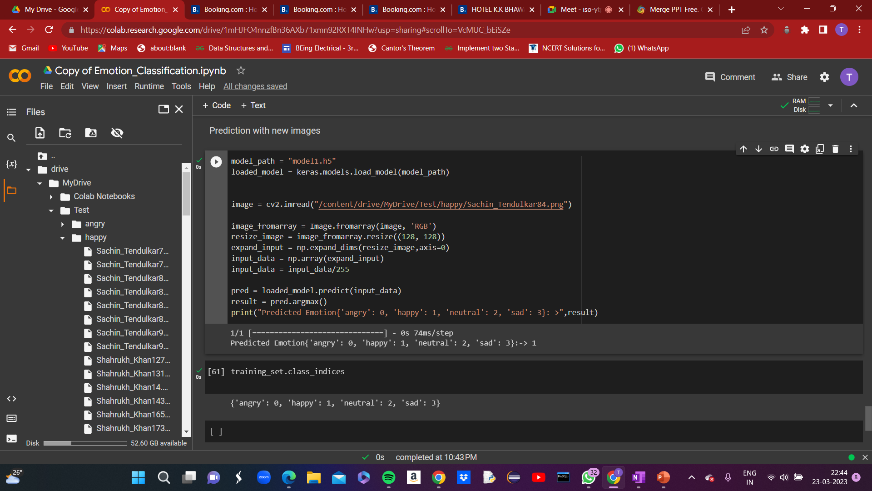
Step-6:Real World Prediction(Happy)

Slide 37

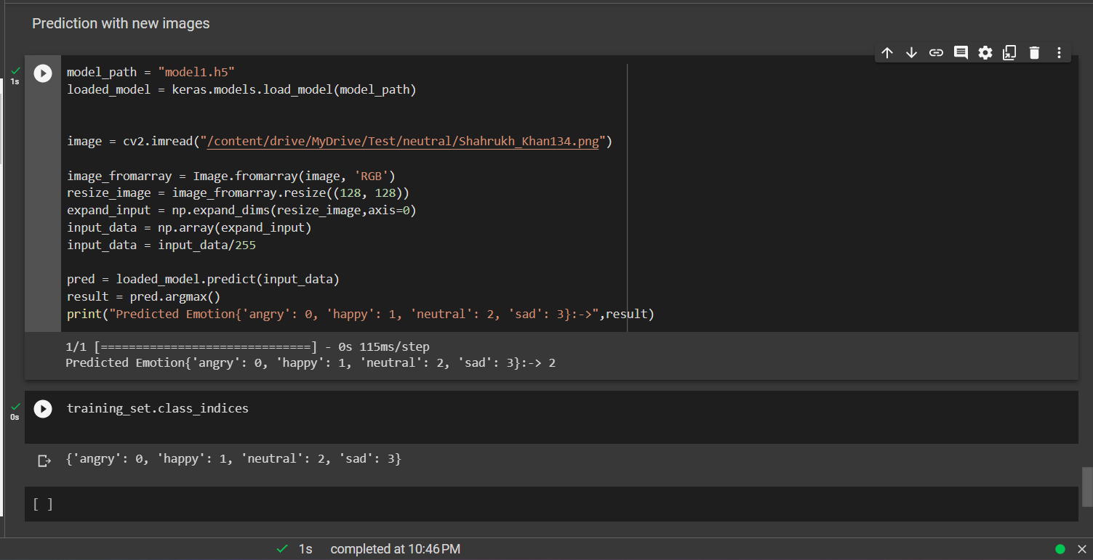
Step-6:Real World Prediction(Neutral)

Slide 38

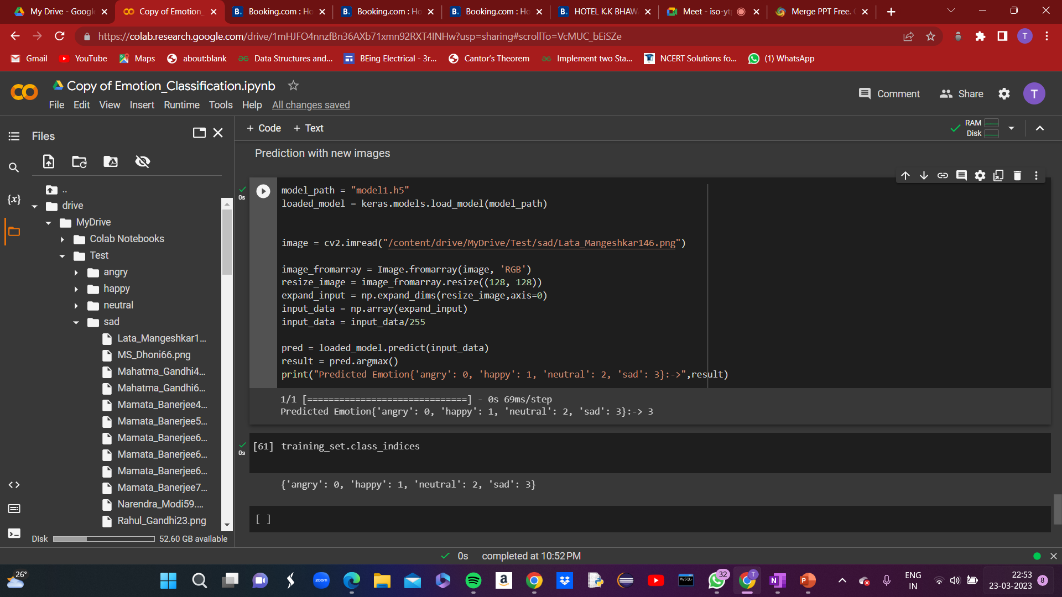
Step-6:Real World Prediction(Sad)

Slide 39
RESULT AND DISCUSSION
In conclusion, the emotion classification model developed using a Sequential CNN approach achieved a decent amount of accuracy on training as well as testing data , indicating that it can accurately classify emotions.
The model's high accuracy is a significant accomplishment, and it demonstrates the effectiveness of using deep learning techniques for emotion classification tasks.
With further testing on new data, the model can be improved to provide even better results.
Overall, the project is a success and showcases the potential of deep learning for emotion classification.

